Slide 1



CCE PROJECT PRESENTATION
Sheheryar Hasan Nasir
Abdullah Shabbir
Umer Karim
Ali Hasnain
Ali Zaidi
Hammas Alauddin
Abdul Wahab

Slide 2

Aims:
To compile data on the employment experience of staff working in Fast NUCES Karachi.
Project 1: Staff Interviews
Scope:
short interviews with staff(janitors, gardeners, security etc) within the premises of Fast Karachi Main campus

Slide 3
Methodology
Interviews conducted on Campus, Anonymously, with the consent of the interviewees
Interviews consist of 3 questions covering duration of employment , positive aspects of employment and finally aspects which may be improved
Keeping inline with project criteria 15 interviews were conducted and compiled

Slide 4

Results
Among interviewees, employment time averaged to 8 years
58.3% of Interviewees were overwhelmingly satisfied with their salaries and employment benefits
41.7% considered the students and faculty interactions to be the best part of working on Campus

Slide 5

Negative responses
Among interviewees 28.4% felt there are no needs for any important changes to be made to the university
Another 28.4% suggested infrastructural changes ranging from changing food stall locations, to expanding the Prayer room
21% raised sanitary concerns like littering on campus
yet another 21% cited managerial improvements, specifically during large events

Slide 6
Aims:
fundraising for charity through student donations
Scope:
Fast NUCES Main Campus and Fast social media spaces
Project 2:Fundraising

Slide 7
Methodology
Using all avenues of communication to alert as many students as possible including Social media Spaces etc
donations were accepted both in the form of cash and online transactions

Slide 8
Results
71,300 PKR was raised
Donations handed over to Ms. Faiza Iqbal, Professor of Civics and Community Service at Fast NUCES Main Campus, Karachi to be distributed to the relevant parties

Slide 9
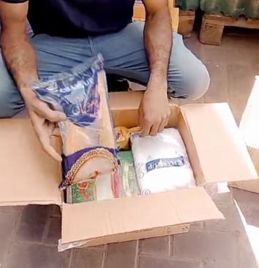
Aim:
Providing rations to the hungry who cannot afford it
Project 3:Ration Drive
Scope:
Visits to Underprivileged communities by car to provide rations

Slide 10
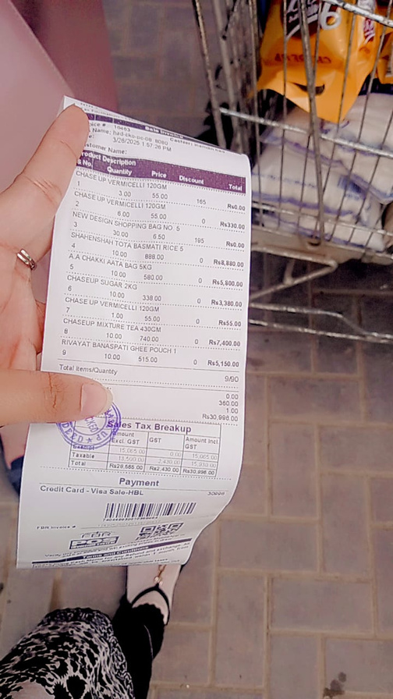
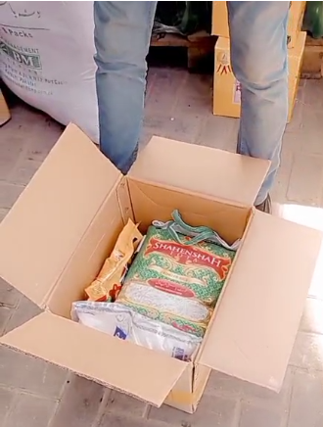
Methodology
Rations packed into boxes and loaded onto the vehicles
vehicles taken to Underprivileged Communities and the boxes of rations provided to the members of this community
to prevent hoarding during distribution, using the vehicle available, the team drove house to house and delivered packages door to door
this drive continued till every package had been handed out.

Slide 11
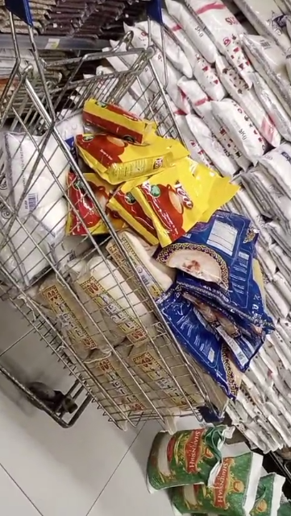
Result
All packages had been distributed successfully
roughly 85 packages had been delivered overall

Slide 12
Conclusion
Project 1: Interviews
Project 2: Fundraising
Project 3:Ration drive
Thank You!

